Slide 1
The Branches of Government at Work
The Civil Rights Movement and Brown v. the Board of Education Decision
This resource series was developed in partnership between the Lou Frey Institute, FL Joint Center for Citizenship & Orange County Public Schools, with generous funding from the Elizabeth Morse Genius Foundation.

Slide 2
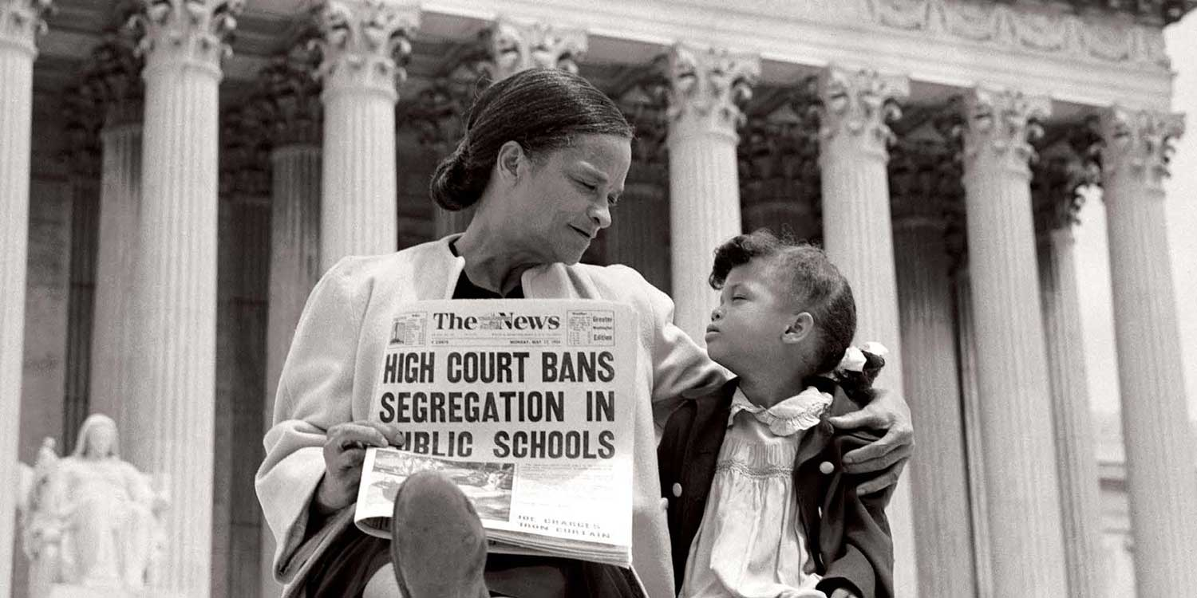
Image 1
Notes:
https://www.nps.gov/archeology/months/september13.htm

Slide 3
Image 1
Mother and daughter embrace on the steps of the Supreme Court as they celebrate the Supreme Court's decision to ban segregation in public schools following the Brown v. Board of Education case.
Notes:
https://www.nps.gov/archeology/months/september13.htm

Slide 4
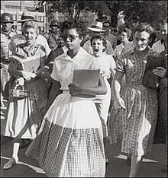
Image 2
Notes:
https://en.wikipedia.org/wiki/Elizabeth_Eckford

Slide 5
Image 2
Elizabeth Eckford, a black fifteen year old freshman, walks to Little Rock Central High School, formerly an all white high school, on the first day of the school year. She is being followed by an angry mob while members of the National Guard look on.
Notes:
https://en.wikipedia.org/wiki/Elizabeth_Eckford

Slide 6
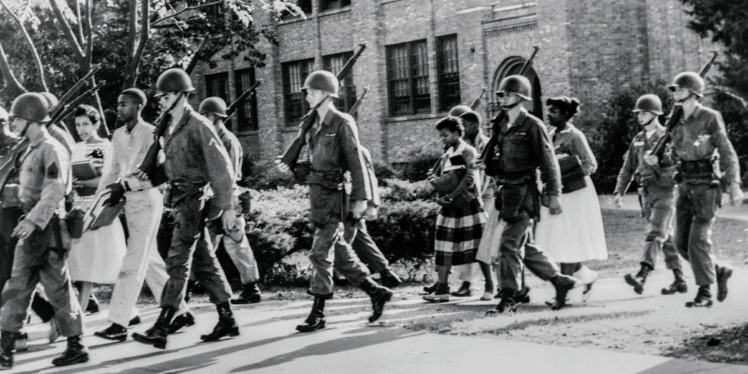
Image 3
Notes:
https://www.loc.gov/pictures/item/94505568/

Slide 7
Image 3
A group of black students leave Little Rock Central High School under state trooper escort and protection after the school began integrating students of different races.
Notes:
https://www.loc.gov/pictures/item/94505568/

Slide 8
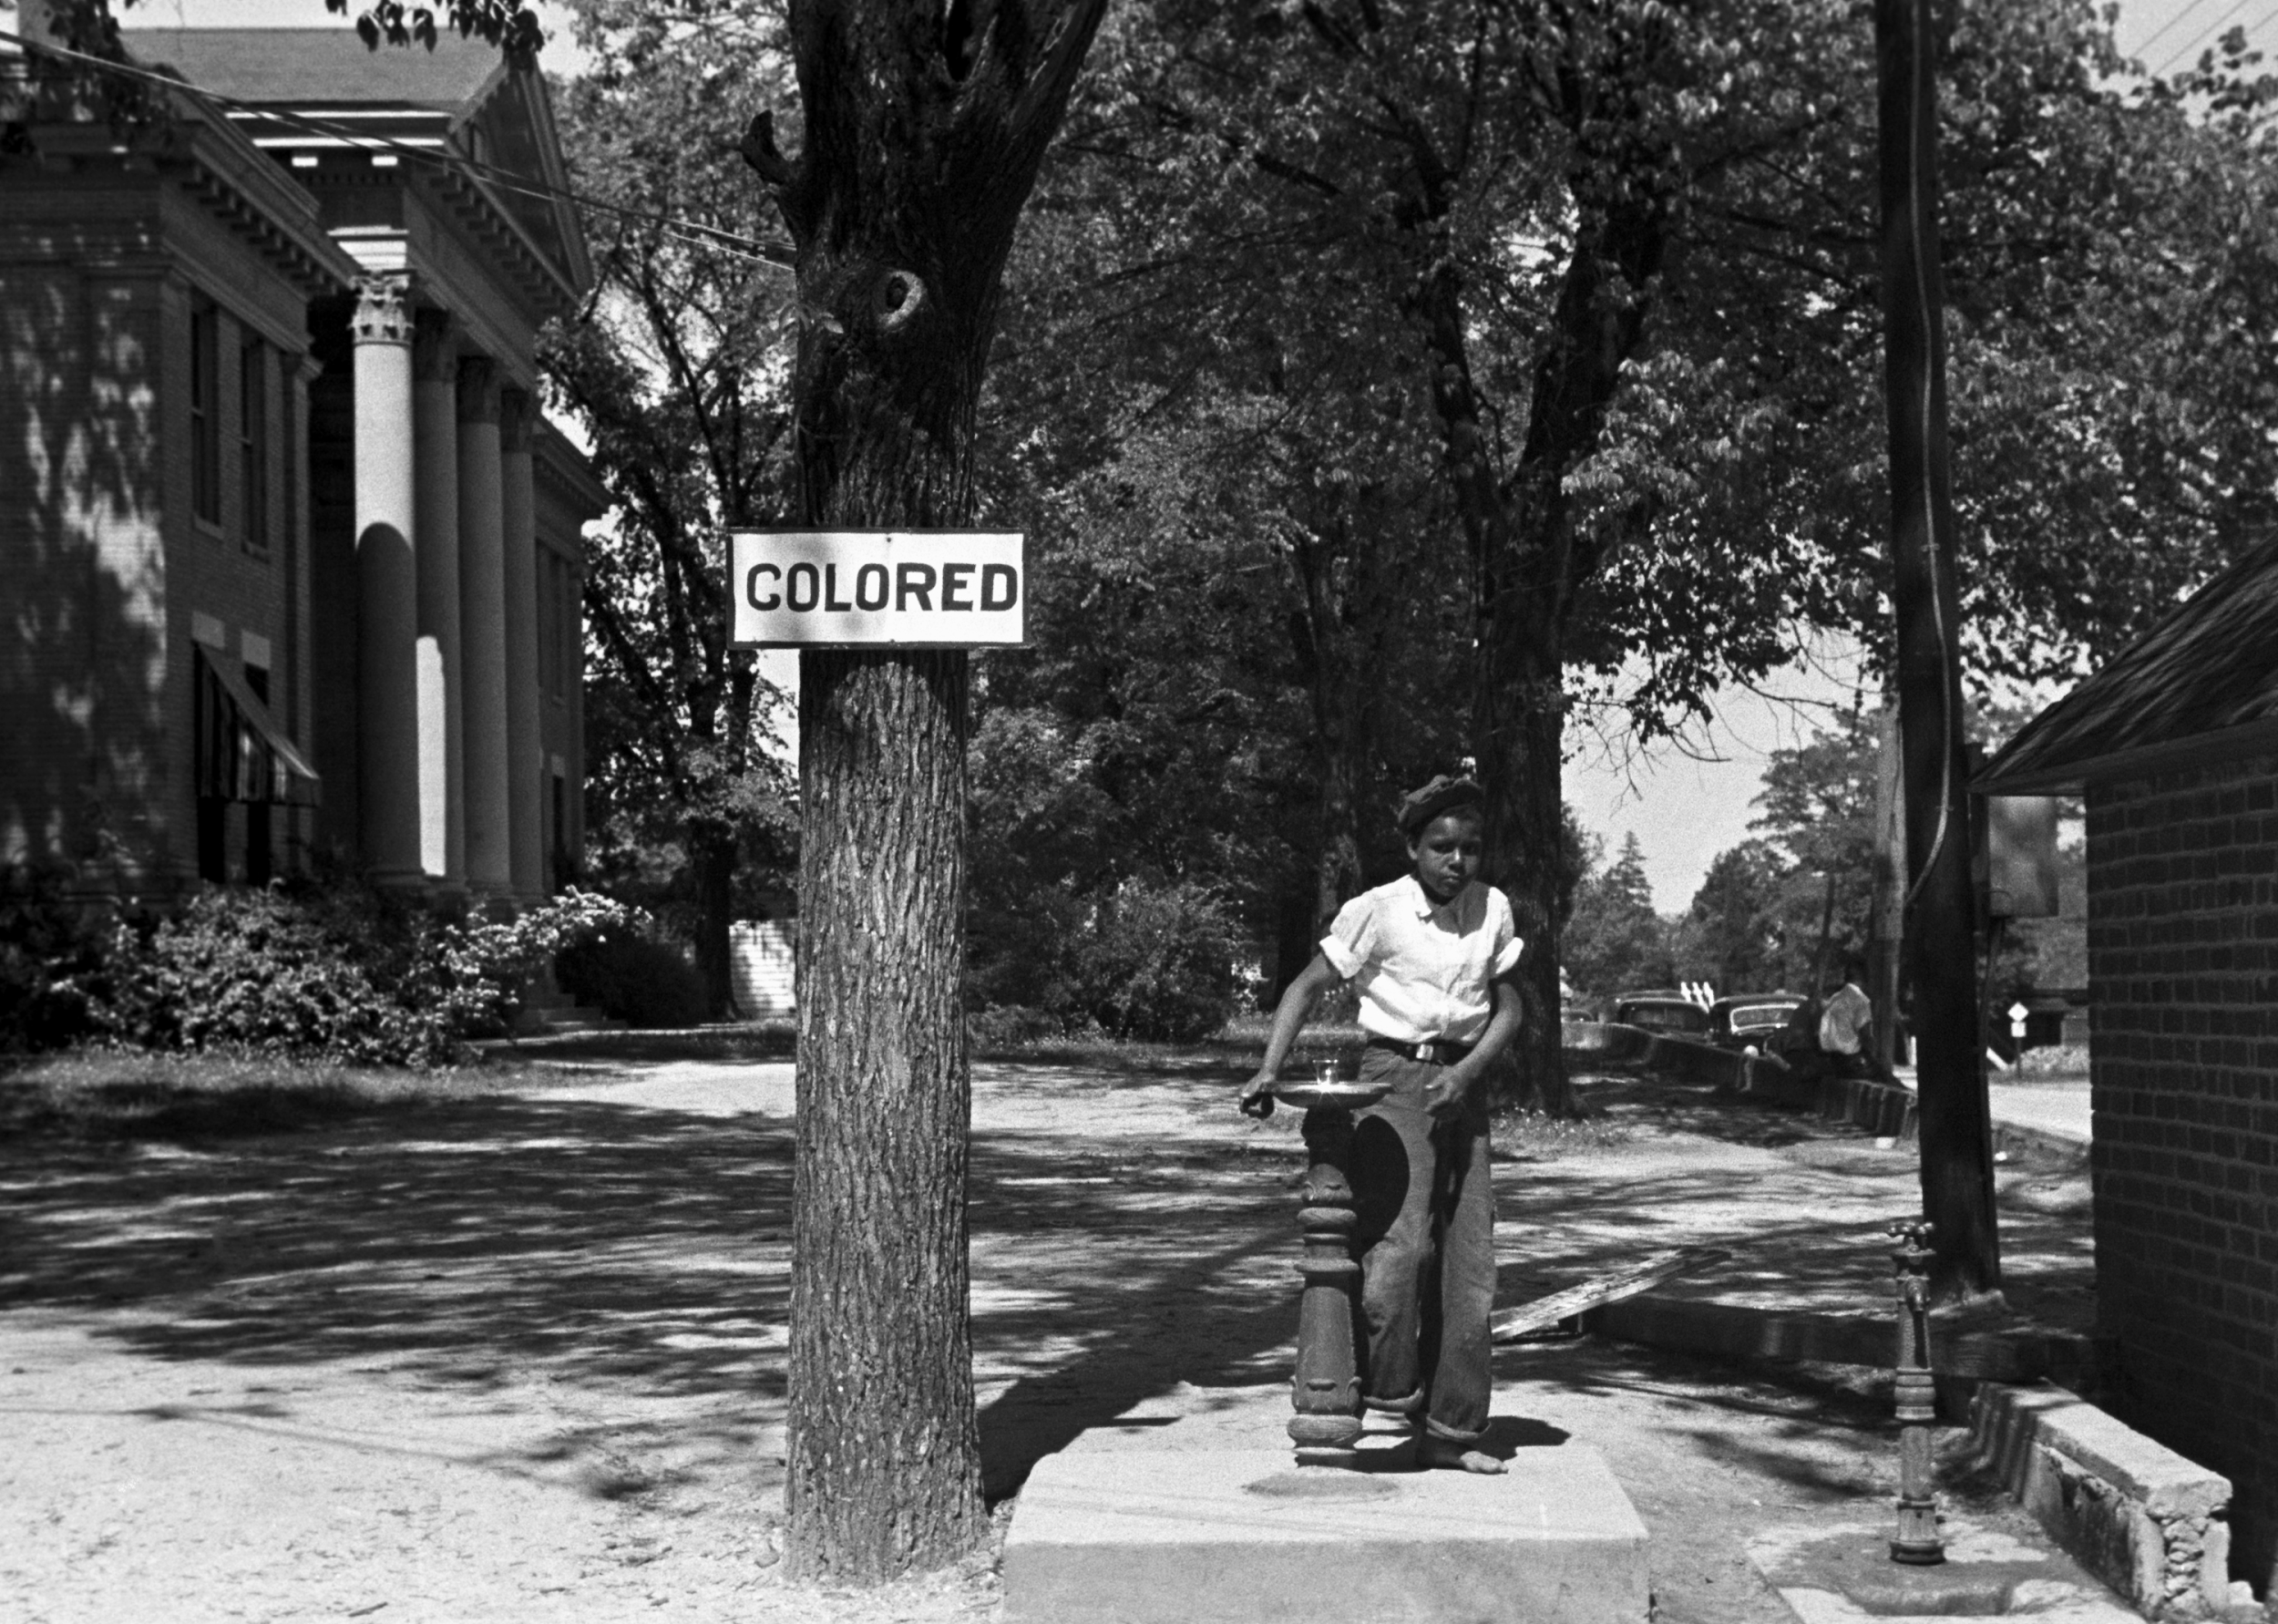
Image 4
A young boy drinks from a segregated water fountain, all public facilities were segregated under the separate but equal, segregation laws.
Notes:
https://en.wikipedia.org/wiki/Discrimination

Slide 9
Image 4
A young boy drinks from a segregated water fountain, all public facilities were segregated under the separate but equal, segregation laws.
Notes:
https://en.wikipedia.org/wiki/Discrimination

Slide 10
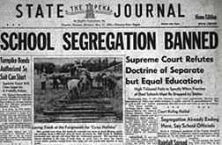
Image 5
Notes:
https://www.archives.gov/publications/prologue/2004/spring/brown-v-board-2.html

Slide 11
Image 5
A newspaper headline in Topeka, Kansas the day after the Supreme Court banned segregation after the Brown v. Board of Education decision.
Notes:
https://www.archives.gov/publications/prologue/2004/spring/brown-v-board-2.html

Slide 12
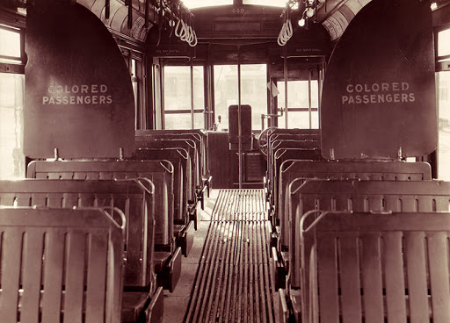
Image 6
Notes:
http://www.encyclopediaofalabama.org/article/h-1248

Slide 13
Image 6
A streetcar in Alabama is an example of segregation laws that ruled over the country. Specific areas for colored passengers are labeled, showing people of color where they were required by law to sit.
Notes:
http://www.encyclopediaofalabama.org/article/h-1248

