Slide 1
The Amazing
Escape Room!
Three Branches Edition
Benchmark SS.7.C.3.3 - Illustrate the structure and function (three of branches of government established in Articles I, II, and III with corresponding powers) of government in the United States as established in the Constitution.
This resource series was developed in partnership between the Lou Frey Institute, FL Joint Center for Citizenship & Orange County Public Schools, with generous funding from the Elizabeth Morse Genius Foundation.

Slide 2
STUDENT INSTRUCTIONS
Take a number, find your classmate with the same number and sit by them.
Today, you will apply all of your knowledge of the three branches and find your way out of our escape room.
You will answer a series of questions that relate to the three branches and the individuals who make up these branches of government.
The questions are typically:
Who is the person, or
What branch of government is this?
Take your time and work together to discuss the potential answer to each clue.
Have Fun!

Slide 3
CLUE
This branch of government handles the day-to-day affairs of our country, such as; protecting our borders, dealing with foreign affairs, and enforcing laws.
What branch of government is this?

Slide 4
CLUE
Sometimes either a single person or a group of people review all the facts related to a case, and come to a final judgement as to whether you should receive a punishment or if a law is unconstitutional.
What branch of government is this?

Slide 5
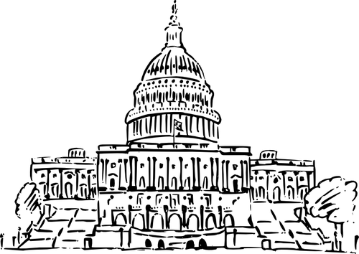
CLUE
You are telling me that one house can fit 435 people in it?
I heard the house next door only has 100 people in it. Hopefully, with all those people they can get some work done!
What branch of government is this?

Slide 6
CLUE
This individual is the head of one of the three branches.
He/She helps to ensure that all laws passed by the United States Congress are being enforced.
He/She has a few cool nicknames, such as; Commander-in-Chief, Chief Diplomat, and Chief of State!
Who is this person?

Slide 7
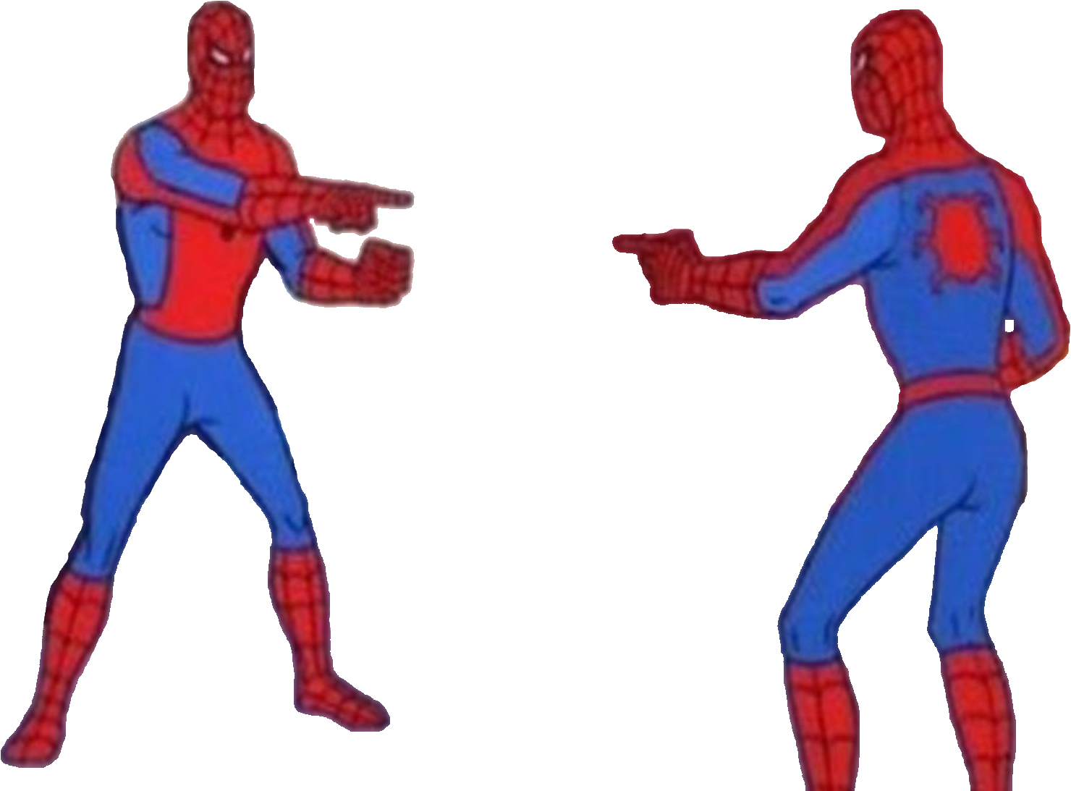
CLUE
If you watch Law & Order this person would most likely be the last person you see.
These individuals are responsible for interpreting the laws created by the legislative branch.
There are usually nine of them and they all like to dress alike. (Twinsies!)
What is their name?

Slide 8
CLUE
I start off as just an idea about how to fix an issue.
Then a bunch of citizens got together with their local congressman and discussed whether or not I should head to Capitol Hill.
If everyone likes me when I get to Capitol Hill, then maybe one day I can became a law!
Who am I?

Slide 9
CLUE
This group of people can rarely be found in a kitchen because they are too busy providing advice to the President.
These individuals tend to be the secretaries (leaders) of the departments that make up the executive branch.
I hope they know how to give advice!
Who am I?

Slide 10
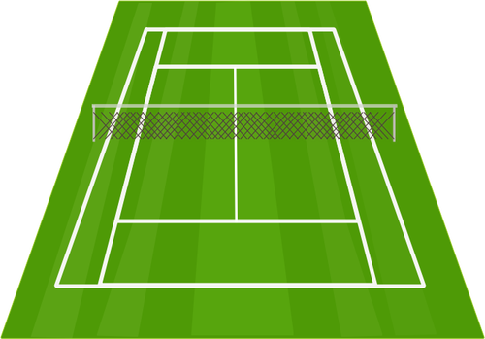
CLUE
I AM SUPREME!
Well more like only here in the United States.
When I make a decision everyone has to listen!
I only worry about the most important issues facing our country, and leave all that other stuff up to the states or the lower level of the system.
Who am I?

Slide 11
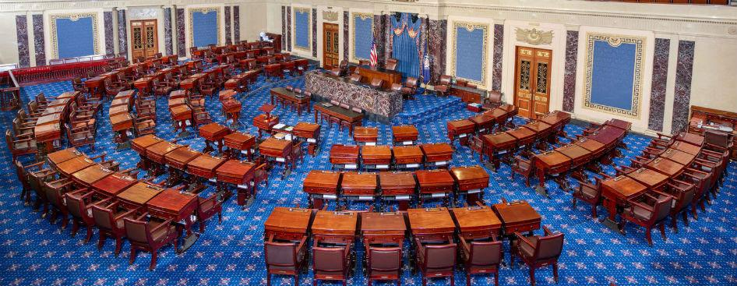
CLUE
I have been here since the Articles of Confederation!
Some people would say that I am the most important branch of government, but some will say this has not been the case in years.
In order to be part of this branch you have to be elected for six years or two years.
What’s the branch of government?

Slide 12
Resources Used
https://publicdomainvectors.org/en/free-clipart/American-flag-style-rectangular-border-vector-image/22827.html
https://publicdomainvectors.org/en/free-clipart/Image-of-police-discipline-branch-in-action/34997.html
https://publicdomainvectors.org/en/free-clipart/US-Capitol-building-vector-drawing/14646.html
https://publicdomainvectors.org/en/free-clipart/Black-and-white-image-of-justice-scale/17275.html
https://publicdomainvectors.org/en/free-clipart/President-J-F-Kennedy-portrait-vector-drawing/25582.html
https://www.deviantart.com/supercaptainn/art/PNG-Meme-Spider-Man-Pointing-at-Spider-Man-782429806
https://publicdomainvectors.org/en/free-clipart/Law-scroll/69434.html
https://publicdomainvectors.org/en/free-clipart/Old-Mens-Club/59925.html
https://publicdomainvectors.org/en/free-clipart/Grass-tennis-court-vector-illustration/25694.html
https://commons.wikimedia.org/wiki/File:United_States_Senate_Floor.jpg

